Slide 1
Structural Basis for Nucleic Acids
Md Mazedul Haq

Slide 2
Learning Objectives
Chemical components of DNA & RNA
Phosphodiester bonds
Hydrogen Bonds

Slide 3
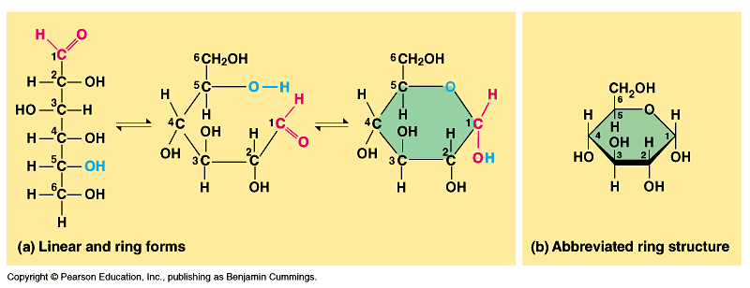
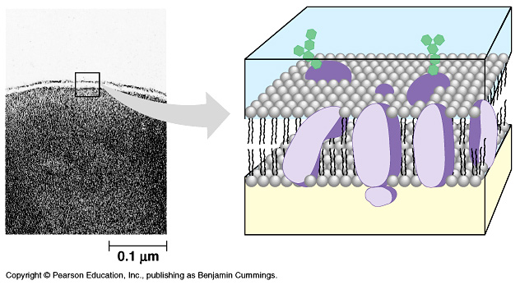
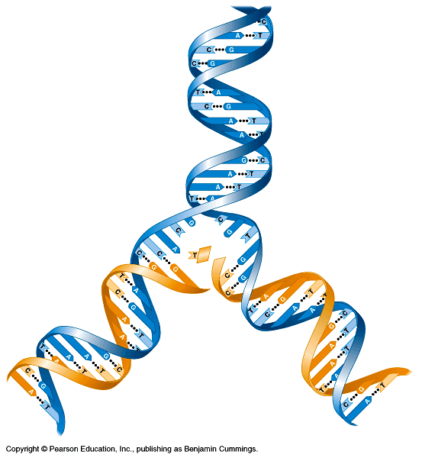
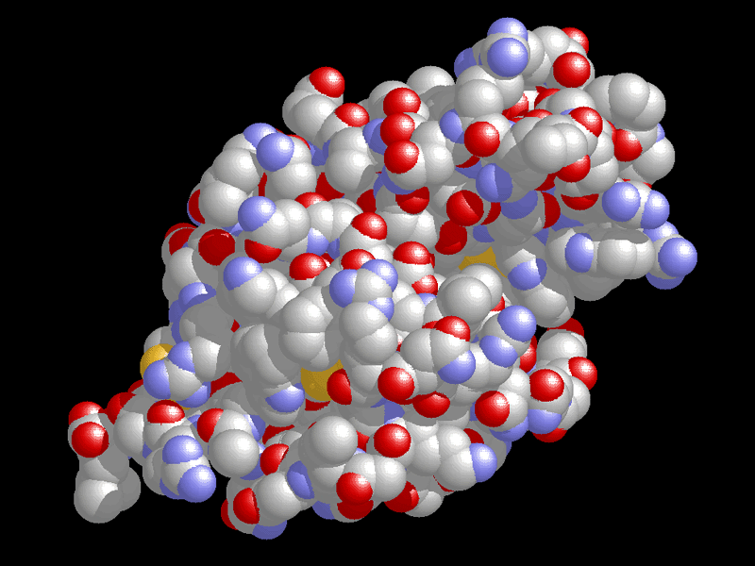
Biomolecules
Four types of biomolecules:
1) Carbohydrates
2) Lipids (fats)
3) Proteins
4) Nucleic Acids
DNA
RNA
ATP

Slide 4
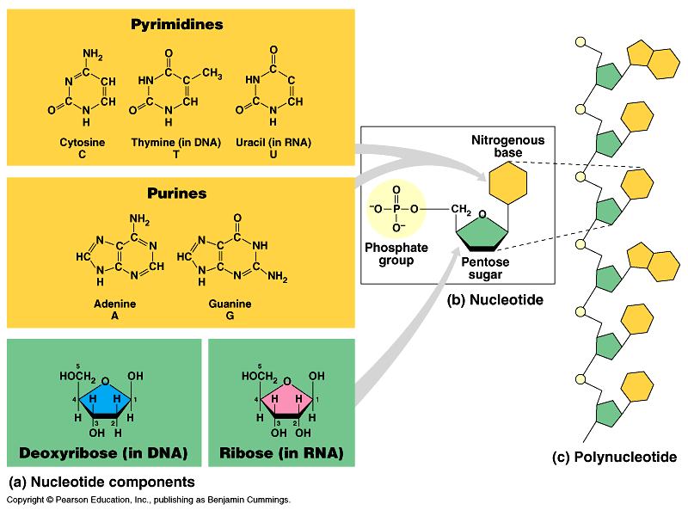
Structure of DNA/RNA
Three Components
Phosphate Group
‘Pentose Sugar’
Nitrogenous base

Slide 5
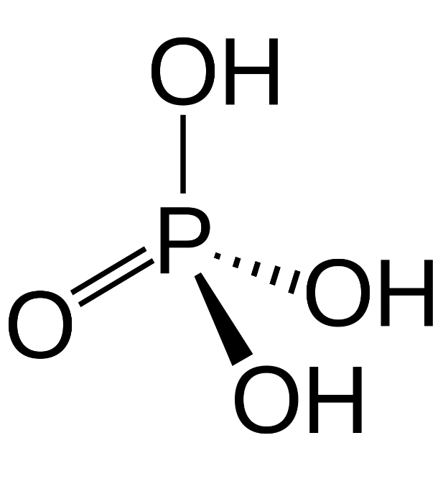
Phosphate Group
one atom of phosphorus covalently bound to four oxygen residues,
two of which may be expressed as a hydroxyl group.
They are relatively reactive molecules that readily form phophoester bonds by the interaction with hydroxyl groups.

Slide 6
Pentose Sugar
Deoxyribose and Ribose are both 5 carbon sugars
What is the difference between them?

Slide 7
Nitrogenous Bases
You need to remember these!

Slide 8
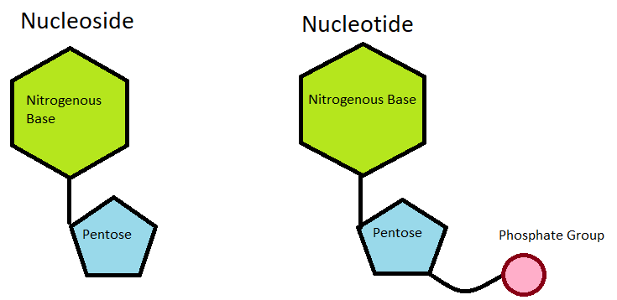
So What?

Slide 9
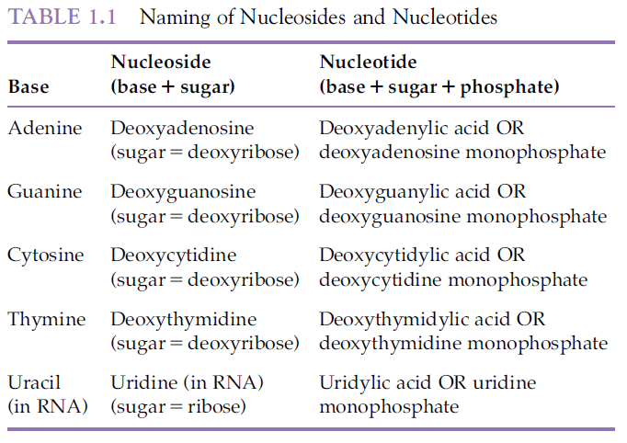

Slide 10
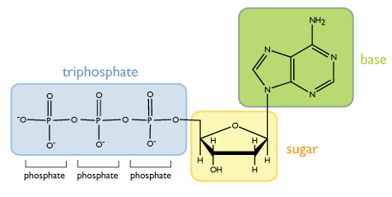
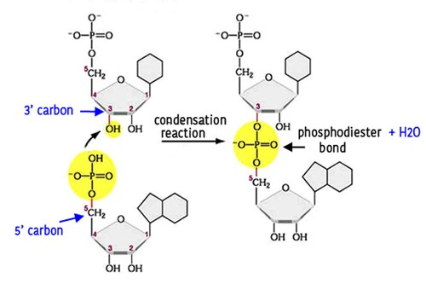
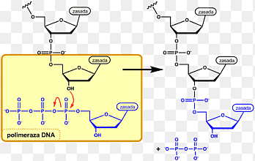
Phosphodiester Bond
Dinucleotide

Slide 11
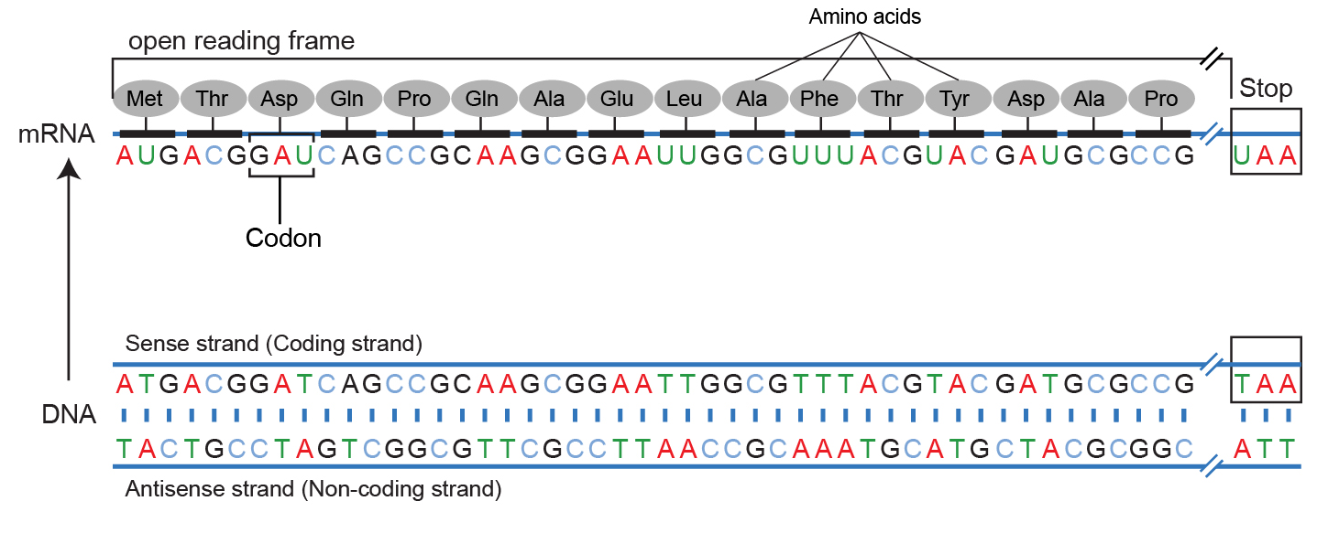
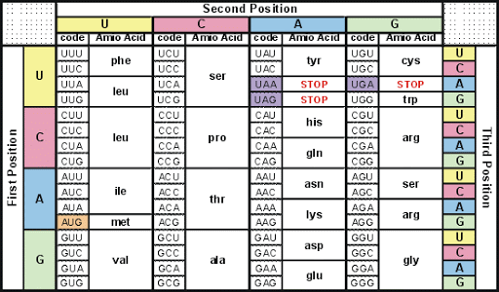
Importance of Phosphodiester Bond
links the sugar molecules and phosphate molecules in the backbone
One of the most crucial components for building DNA and RNA
It maintains the integrity of the genetic code

Slide 12
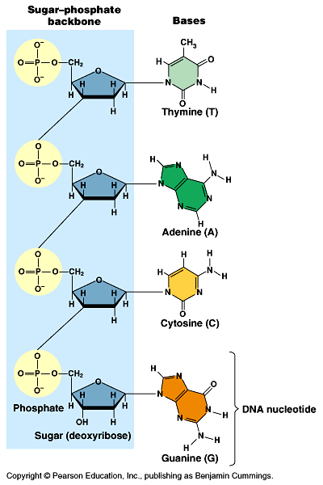
DNA/RNA are Polymers of Nucleotides
+
=

Slide 13
A DNA Strand!

Slide 14
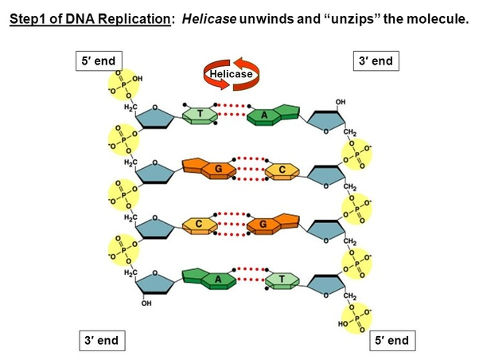
Two DNA Strands!
The sequence of nitrogenous bases is the code of DNA

Slide 15

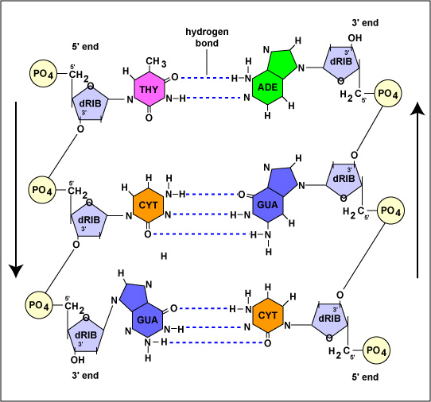

Slide 16
Importance of Hydrogen Bonds
DNA has a double-helix structure because hydrogen bonds hold together the base pairs in the middle.
Without hydrogen bonds, DNA would have to exist as a different structure.
A relatively high boiling point due to hydrogen bonds. Without hydrogen bonds, double stranded DNA would not be stable.
The region of ‘A-T’ base pairing is more prone to mutation than the ‘G-C’ base pairing due to.
During the primer design the ration of A-T, G-C content is essentially important due to the hydrogen bonds.

Slide 17
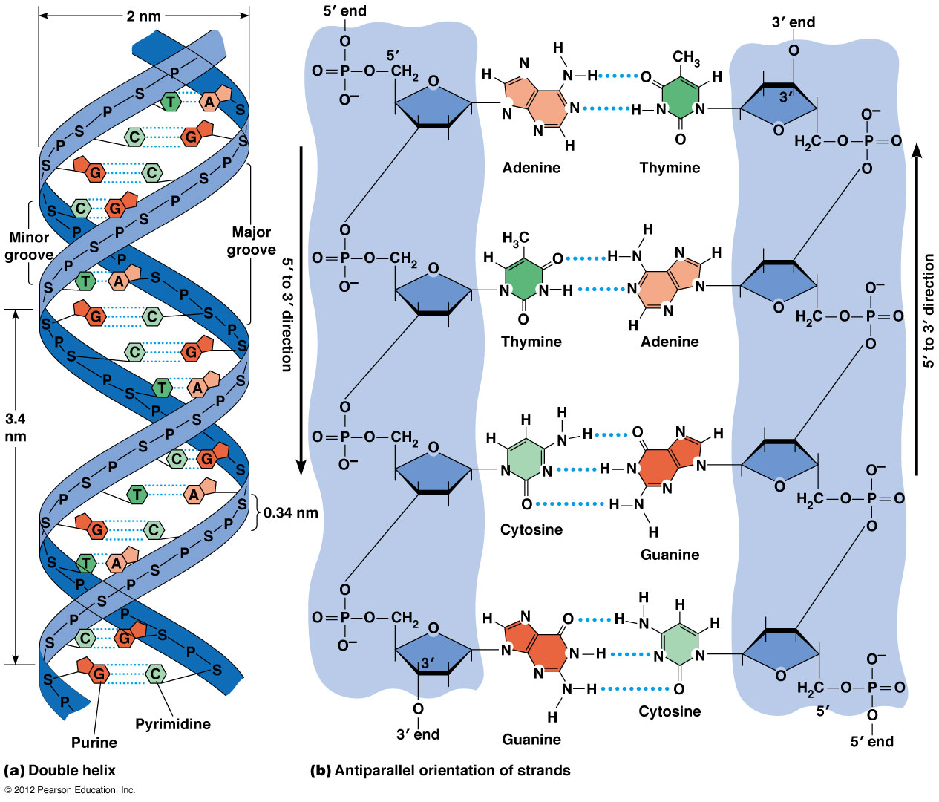
The Double Helix

Slide 18
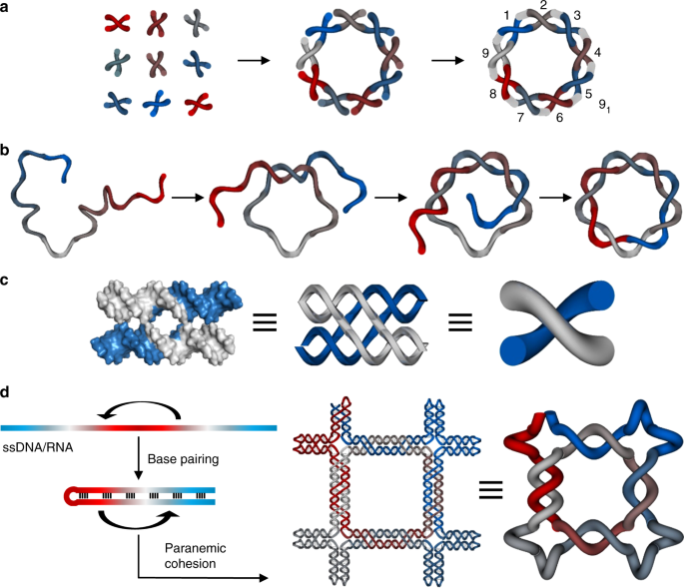
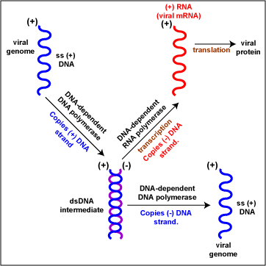
Single Stranded DNA!

Slide 19
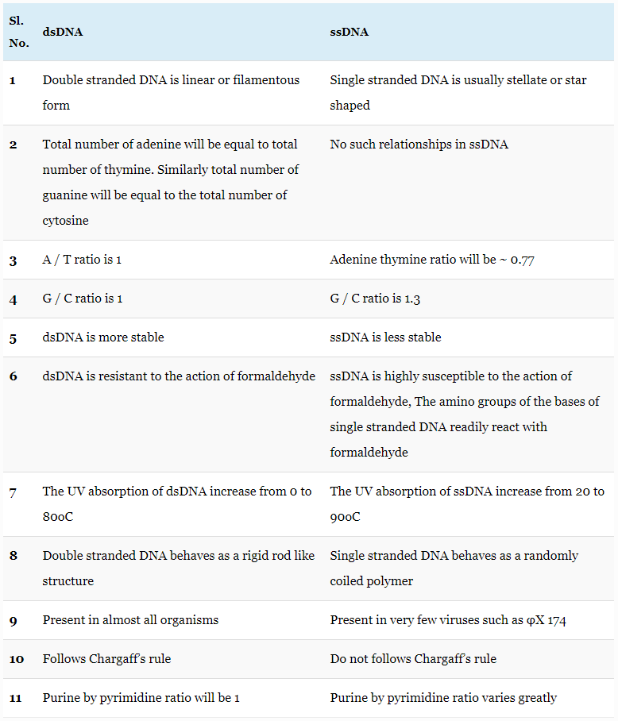

Slide 20
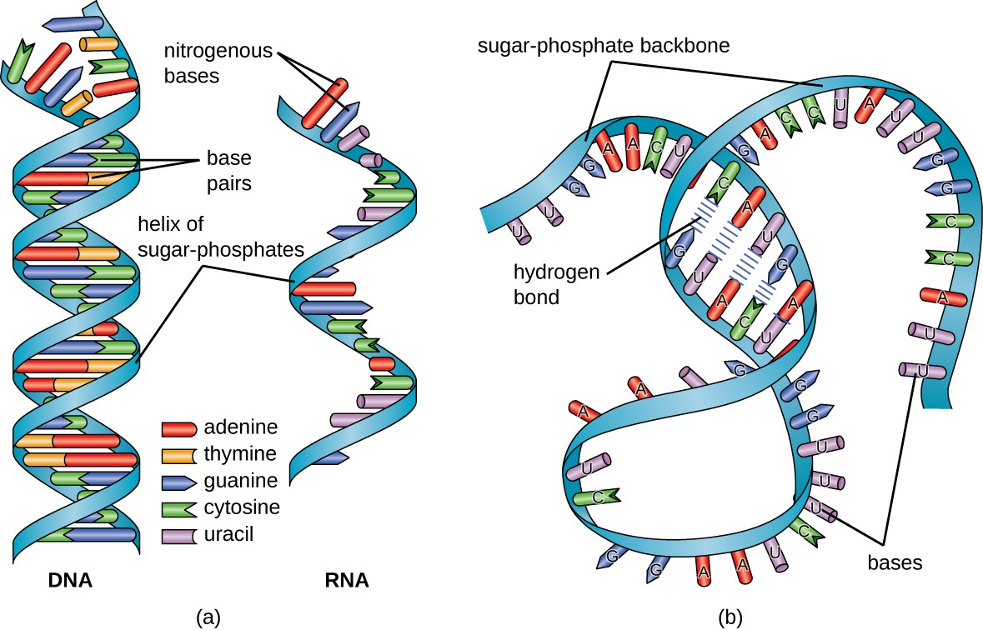
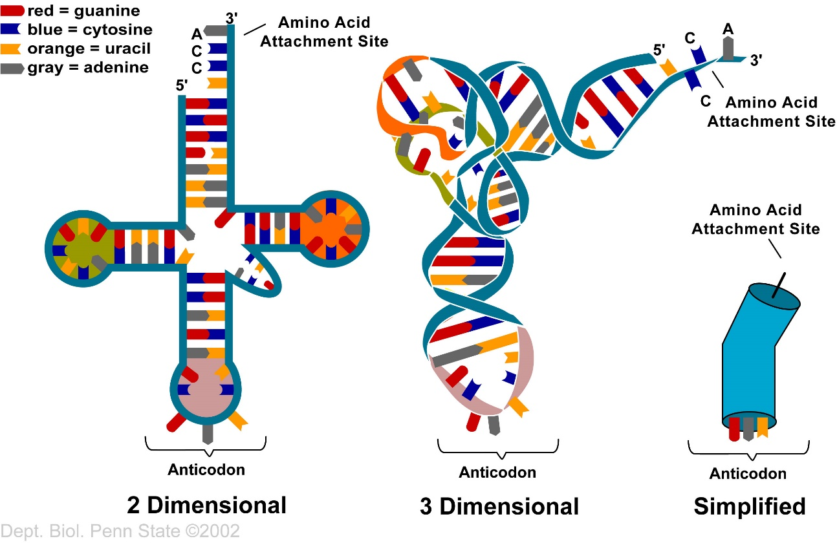
Common Features of RNA

Slide 21
THANK YOU

